Slide 1

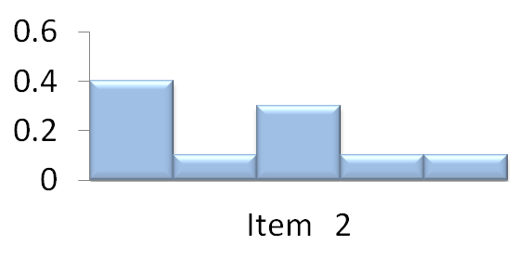
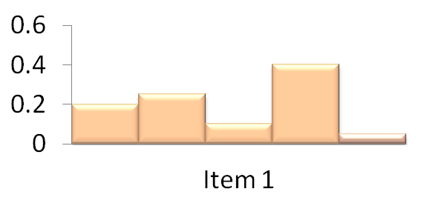
□Research Question 1
How do we explain existing recommendation models?
Compensatory Rules
Decision
Process
Non-Compensatory Rules

